Slide 1


“FOOD DELIVERY WEBSITE”
SRS DOCUMENTATION

Slide 2


Food Delivery Website
A food delivery website is an online platform where users can browse through a variety of restaurants, choose dishes from their menus, place orders, and have the selected food items delivered to their specified location.
It offers a convenient way to enjoy restaurant-quality meals from the comfort of your home or office, saving you time and effort.
LMS Username | Name | Batch
732720104011 | DEEPAK .G | TEAM CB7-4
732720104019 | HARISH.C | TEAM CB7-4
732720104001 | AMBALAM .A | TEAM CB7-4
732720104018 | HARI PRAKASH .M | TEAM CB7-4
732720104022 | KISHORE BILLGATES .M | TEAM CB7-4

Slide 3

SRS Documentation:
ABSTRACT:
Food delivery websites have transformed the culinary landscape, redefining how people experience dining. These platforms serve as online conduits that effortlessly connect users to a myriad of restaurants, offering a virtual journey through diverse cuisines and culinary traditions. Users navigate intuitive interfaces to explore menus, select dishes, and place orders, all from the comfort of their location. The integration of secure payment gateways ensures smooth transactions and peace of mind.
Beyond convenience, food delivery websites contribute significantly to the local economy by boosting restaurant visibility and patronage. They cater to various dietary preferences, making dining more inclusive. These platforms also cater to the fast-paced lifestyles of today, providing an invaluable solution for individuals seeking quality meals without the hassle of cooking or dining out.

Slide 4
SRS Documentation:
SCOPE OF THE SYSTEM:
Online Food Ordering System is the web based application intended for restaurant's Businesses. It provide various feature such as searching, viewing and selection of food items from restaurant for customers. This Application also provides restaurant management and menu management for restaurant manager or owner.
This system is a bunch of benefits from various point of views. As this online application enables the end users to register to the system online, select the food items of their choice from the menu list, and order food online.
One of the various benefits of this is system is that if there is rush or a huge crowd present in the restaurant then in that case sometimes unavailability of tables cut downs the restaurants customer

Slide 5
Introduction
Purpose of the Project:
The purpose of this SRS is to outline both the functional and non-functional requirements of the subject Restaurant food ordering system. In addition to said requirements, the document also provides a detailed profile of the external interfaces, performance considerations and design constraints imposed on the subsequent implementation.
The document should act as a foundation for efficient and well-managed project completion and further serve as an accurate reference in the future.
Document Conventions:
JAVA -> Platform independence
SQL -> Structured query Language
ER -> Entity Relationship
UML -> Unified Modeling Language
IDE -> Integrated Development Environment.

Slide 6

Need of the system:
NEED OF THE SYSTEM:
In This Pandemic Situation Online was the only option available to all sectors, including food industry . It was the Need of Situation So, The Online food ordering application had to be implemented.
With application, customers can easily browse all the dishes the restaurant has available, customize dishes to their requirements and place an order. It can also save their favourite orders allowing them to easily re-order that in the future.

Slide 7

Requirement Analysis
Functional Requirement:
The food delivery website should allow users to browse restaurant menus, select dishes, place orders, and track their delivery in real-time.
Key Features:
User Authentication.
Restaurant Listings.
Menu Browsing.
Order Customization.
Cart Management.
Secure Payments.
Order Confirmation.
Real-time Tracking.
Delivery Updates.
Rating and Feedback.
User History

Slide 8
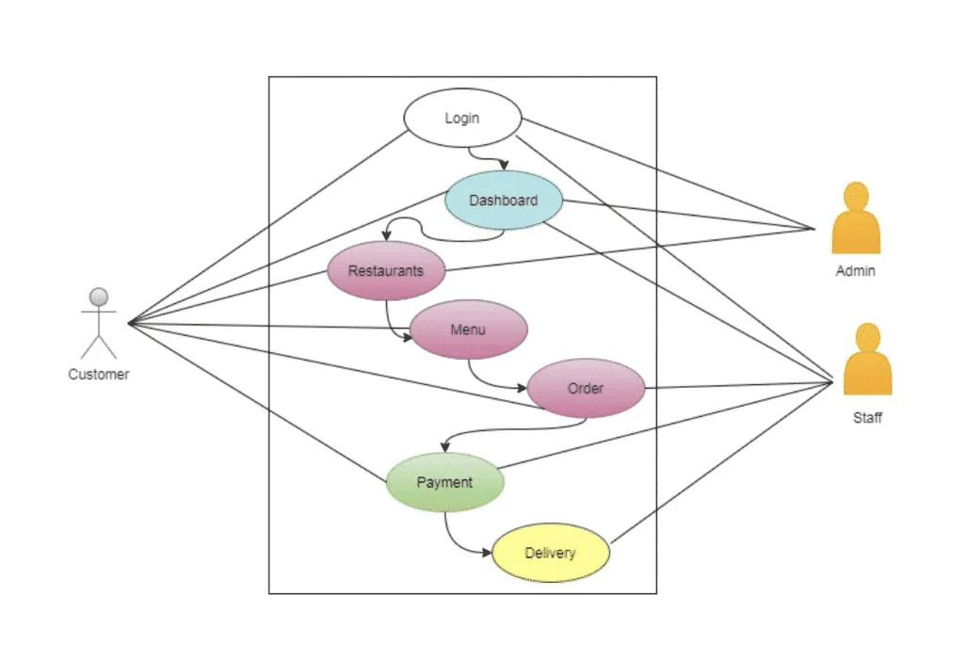
System Design
Usecase Diagram:

Slide 9
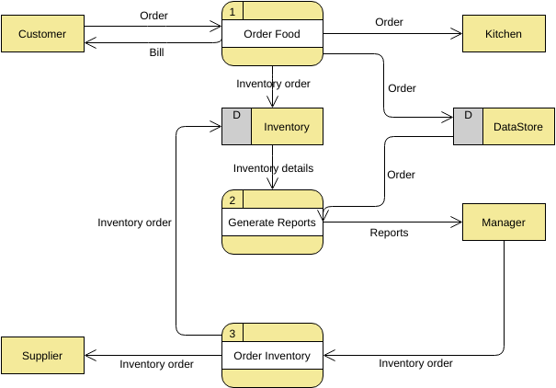
System Design
Data Flow Diagram:

Slide 10
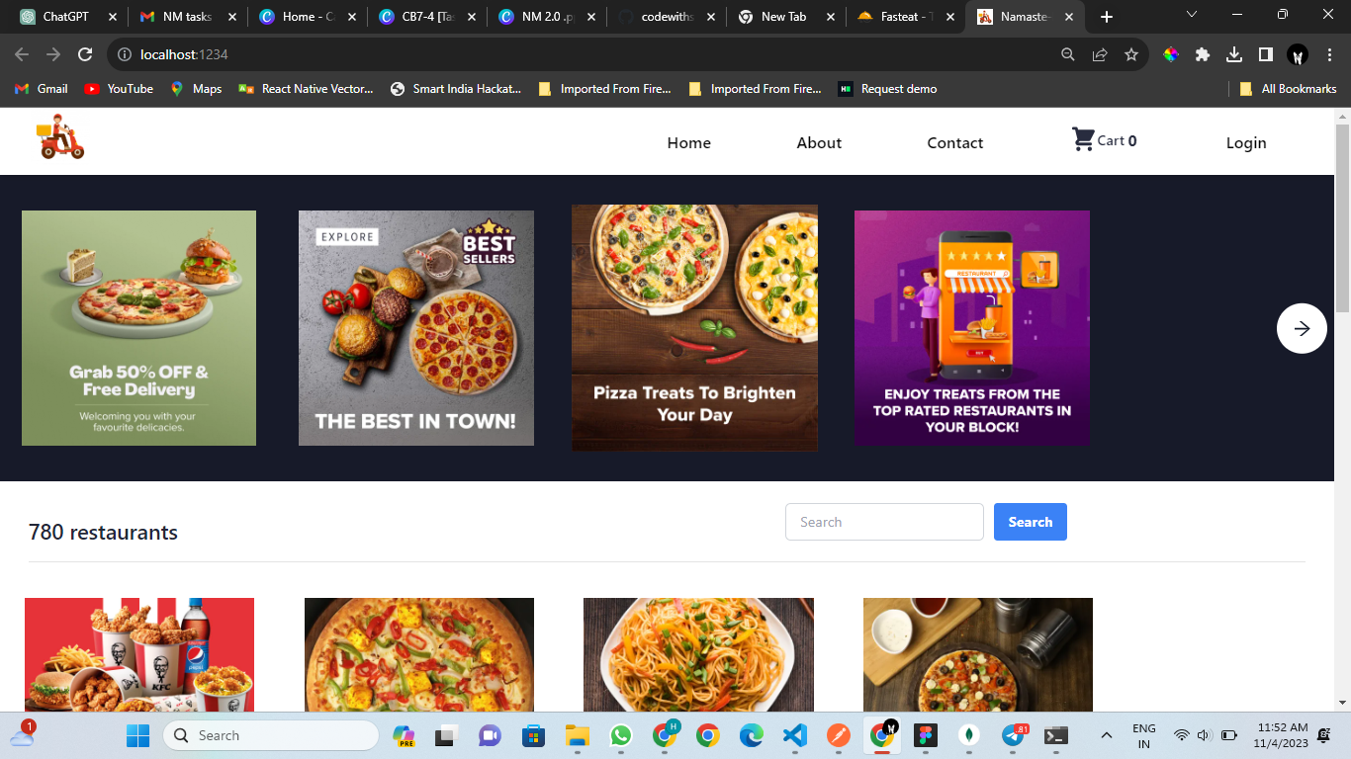
Frontend Design
Screenshots of React Frontend:

Slide 11
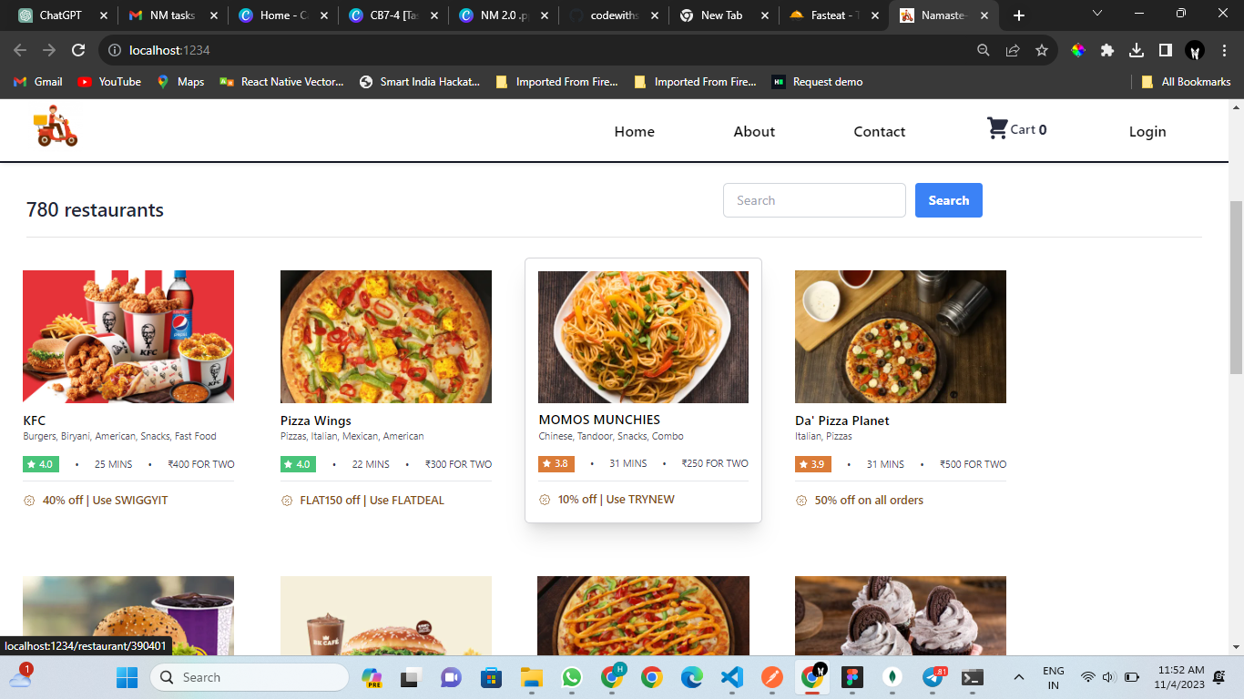
Frontend Design
Screenshots of React Frontend:

Slide 12
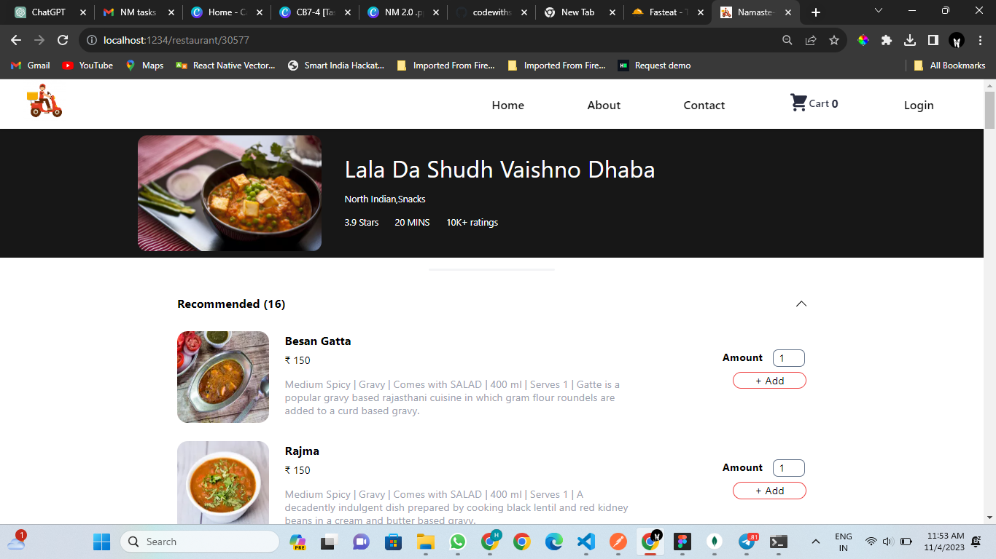
Frontend Design
Screenshots of React Frontend:

Slide 13
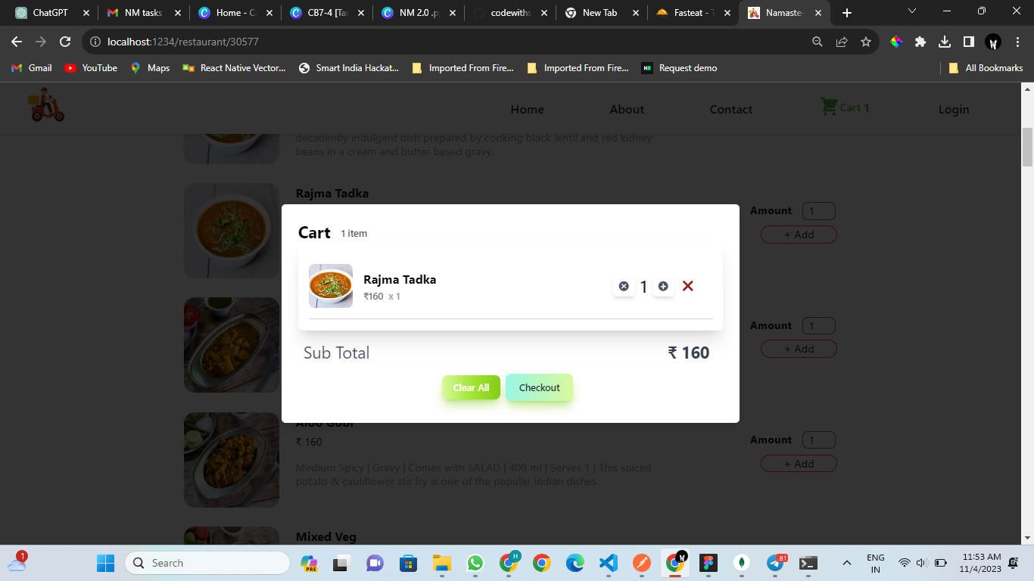
Frontend Design
Screenshots of React Frontend:

Slide 14








Assessment Parameter
Gather requirements for the
project
add Readme.md file with description of the project
Prepare database design schemas
Check-List
Commit all changes with "first commit"
Get your initial project Structure
ready
create a repository on github related to project
Initiate a git repository
Push your changes to github

Slide 15


Submission Github
https://github.com/Harish-78/NM_FoodDeliveryWebsite.git

Slide 16


